Slide 1

GAME PROGRAMMING
From
Ms. Neha Kamble

Slide 2
UNIT I Mathematics for computer Graphics, DirectX
Main topics
Cartesian coordinate system
Vectors
Transformations
DirextX

Slide 3
1. Cartesian Coordinate system
The cartesian XY plane
Y
-X
X
-Y

Slide 4
Function Graph
We have different function like:
Linear function y = mx+c
Quadratic function y = ax² + bx + c
Cubic function y = ax³ +bx² +cx + d
Trigonometric function y = a sin(x)

Slide 5
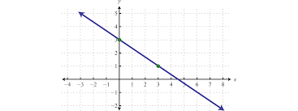
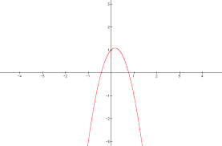
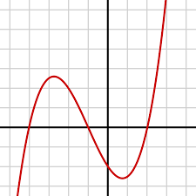
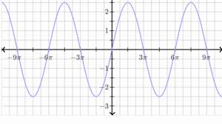
Graphs
Linear function
Quadratic function
Cubic function
Trigonometric function

Slide 6
Geometric Shapes
2D Shapes
3D Shapes
Polygonal Shapes
Area of Shapes

Slide 7
Theorem of pythagoras in 2D
To calculate the distance between two points
Now we apply the theorem on two arbitrary points
point P1(x₁,y₁) and P2(x₂,y₂)
Then the distance d between P1 and P2 is calculated as
d = √Δx² + Δy²
Where Δx= (x₂ ₋ x₁) and Δy= (y₂ ₋y₁)

Slide 8
Theorem of pythagoras in 3D
To calculate the distance between two points
Now we apply the theorem on two arbitrary points
point P1(x₁,y₁,z₁) and P2(x₂,y₂,z₂)
Then the distance d between P1 and P2 is calculated as
d = √Δx² + Δy² + Δz²
Where Δx= (x₂ ₋ x₁)
Δy= (y₂ ₋y₁)
Δz= (z₂ ₋ z₁)

Slide 9
Euler's Rule
It show as the relationship between vertices, edges and faces of 3D polygon object
Faces + vertices = edges + 2

Slide 10
Vectors
Vectors are used for computing angle between lines and orientation of surface.
They give coherent structure to compute the behaviour of a dynamic object in computer animation and illumination model of rendering.
There are two important things
Direction
Magnitude

Slide 11
Direction
Y
(X2,y2)
r
(X1,y1)
(X3,y3)
s
(X4,y4)
X
Vector r is calculated by
X_{r} = (x2-x1) y_{r} = (y2-y1)
Vector s is calculated by
X_{r} = (x4-x3) y_{r} = (y4-y3)

Slide 12
Magnitude of vector
Magnitude of vector r is given by ||r|| and is calculated by using the theorem of Pythagoras.
||r||= √Δx² + Δy²
Δx= x_{h} - x_{t} Δy = y_{h} - y_{t}

